Slide 1
Heart Rate Detection from Ballistocardiogram Signals: A Julia Implementation
Presented by: Heba Ahmed Magdy

Slide 2
Outline
Introduction
Environment Setup
Implementation
Evaluation Metrics

Slide 3
Advanced Biostatistics (Project)
Introduction
Estimate Heart Rate (HR) from Ballistocardiography (BCG) signals, then statistically evaluate the estimation accuracy against reference ECG recordings across multiple patients.
This project is implemented in Julia, based on an existing reference pipeline originally written in Python and published on Code Ocean.

Slide 4
Advanced Biostatistics (Project)
Environment Setup
Installed VMware Workstation Pro to create a virtual machine environment.
Mounted and configured Ubuntu Linux on VMware.
Installed Julia on Ubuntu.
Used the Julia REPL (Read–Eval–Print Loop) to run and test Julia scripts.

Slide 5
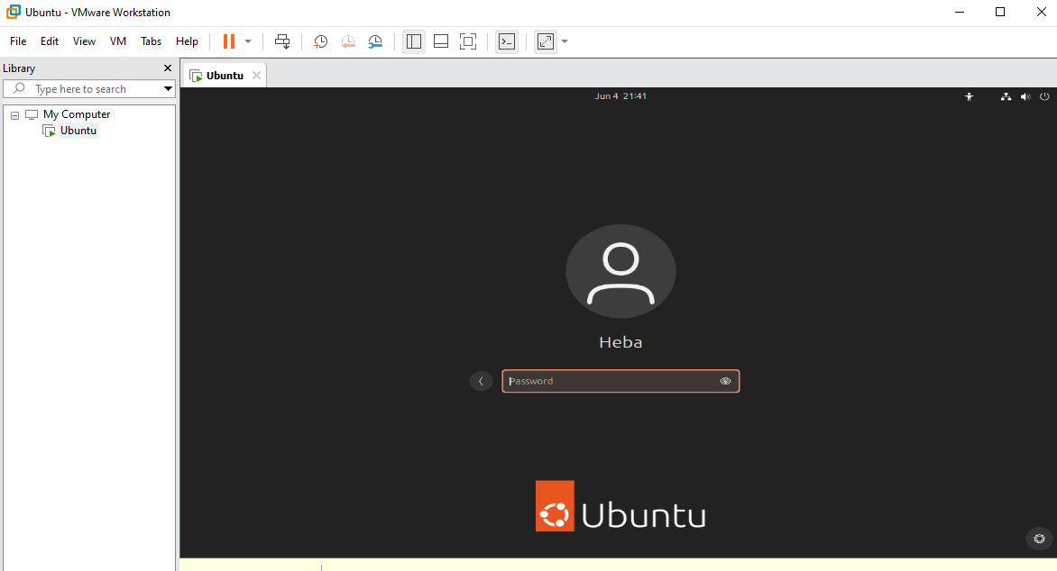
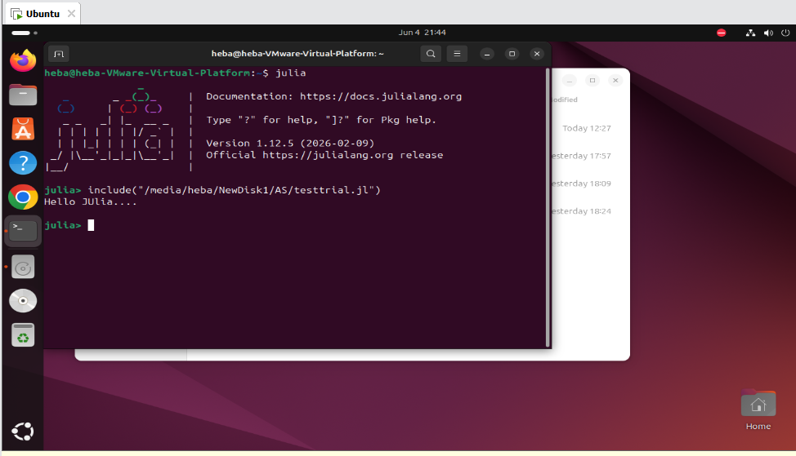
Advanced Biostatistics (Project)
Environment Setup

Slide 6
Advanced Biostatistics (Project)
Implementation (Phase1)
1. Convert reference code (from Code Ocean) to Julia
└── Using single BCG sample data file (fs = 50 Hz)
2. Modular code design
└── Each processing stage implemented as an independent, reusable function
├── Entry point : “mainEntry.jl”
├── Signal processing : “data_preprocessing.jl”
└── Evaluation : “metrics_computation.jl”,
”p_value_calculations.jl”,
“pearson_relation_coeff.jl”,
”regression_plot_and_bland_altman_plot.jl”

Slide 7
Advanced Biostatistics (Project)
Implementation (Phase 2)
1. Run the obtained Julia code on a single file from the new dataset
└── Single file validation (fs = 140 Hz)
2. Run the code across all patients from the new dataset
3. Calculate metrics by comparing BCG-estimated HR against reference ECG signals
└── MAE, RMSE, MAPE, Pearson r, p-value, Regression Plot, Bland-Altman Plot

Slide 8
Advanced Biostatistics (Project)
Evaluation Metrics
Metric | Value | Metric | Value
MAE | 24.642 bpm | Pearson r | −0.5694
RMSE | 26.348 bpm | t-stat | −3.0977
MAPE | 42.339 % | p-value | 0.002837

Slide 9
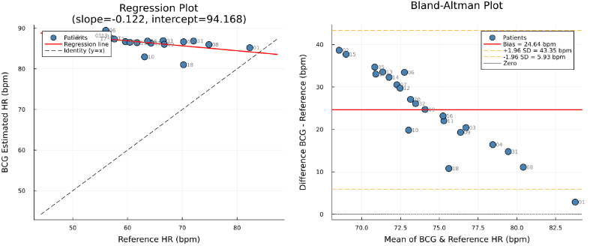
Advanced Biostatistics (Project)
Regression plot and Bland–Altman plot

Slide 10
Advanced Biostatistics (Project)
Questions
Slideegg

Slide 11
Advanced Biostatistics (Project)
Thank You!

